Slide 1

SUMMER INTERNSHIP PROJECT ACTIGRAPHY VISUALISATION TO ANALYSE CHILD OBESITY IN QATAR
By: Richa and Kaushiki
Mentors: Meghana and Michael
18th June,2017

Slide 2
Introduction
Obesity increases the risk of diseases and reduces mental well-being.
Child obesity is a highly complex condition where genetics, environment, education, socio-economic status, climate and many other factors play a major role.
Information about lifestyle, activity levels and sleep can help patients and doctors in decision making.
Wearable devices are becoming increasingly popular for monitoring physical activity and sleep in clinical domains.

Slide 3
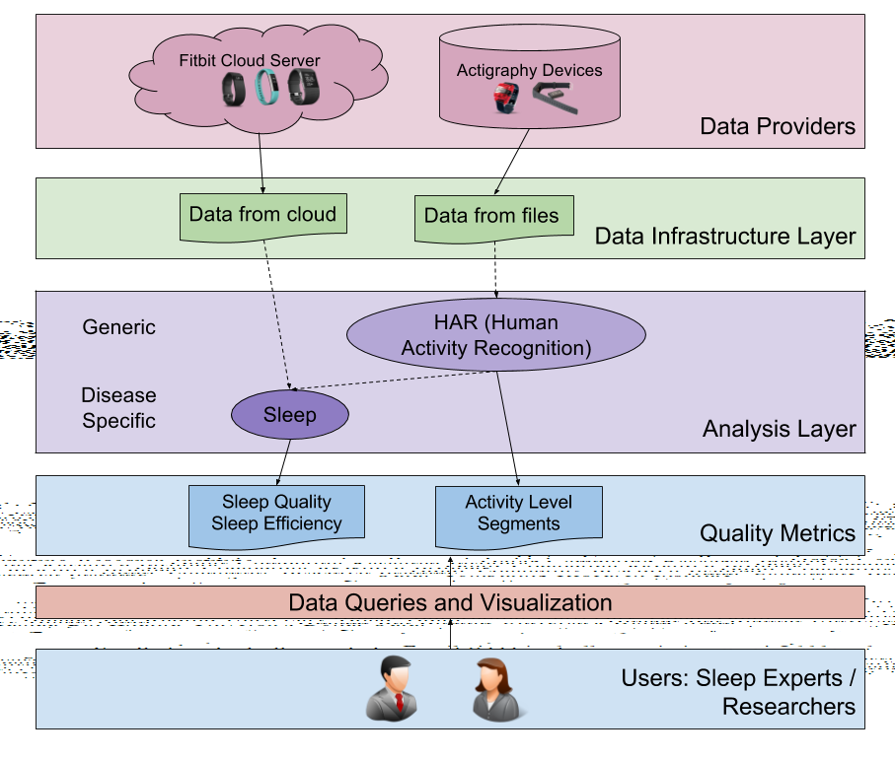
360QS TOOLKIT
The 360QS toolkit was tested within a research project for childhood obesity in Qatar called ”Adaptive Cognitive Behavioral Approach to Addressing Overweight and Obesity among Qatari Youth”.
Quantified technologies integrates the individual’s social media, mobile, health and wearable data.

Slide 4
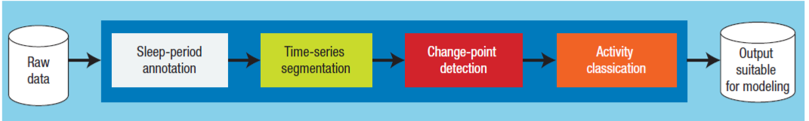
Data Handling
For ActiGraph devices, data has to be downloaded manually via proprietary software
The files generated contains minute level data and are stored into the database.
Physical activity data is used to is used to run human activity recognition algorithm and generate activity levels (light/ moderate/ vigorous activity).

Slide 5
Dashboard
HTML,NVD3,D3 and JavaScript is used for the frontend.
Focuses on visualisation of biometrics and physical activity data for groups and individuals.
Compares data across time and among reference individuals.
Compares BMI and physical activity during the weekdays and weekends and for a week on the basis of the selected option from the dropdown menus.

Slide 6
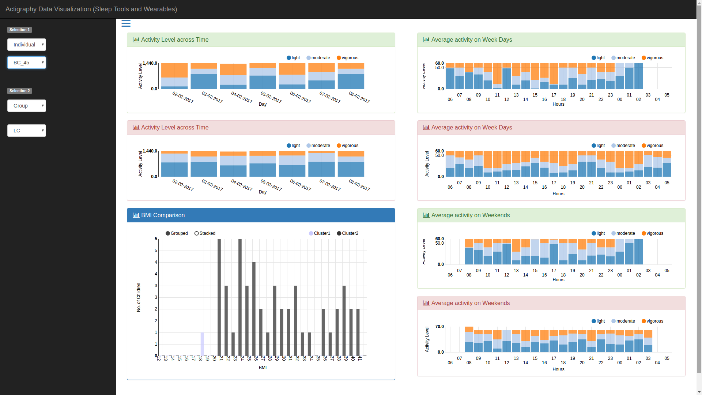

Slide 7
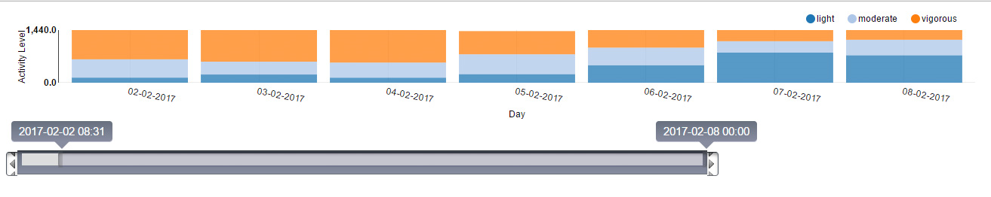
The user can use a slider to filter out days with more than the selected number of sedentary hours by using JQuery
.

